Slide 1
Database Management
Tools
Shahriar’s Analytical Academy

Slide 2

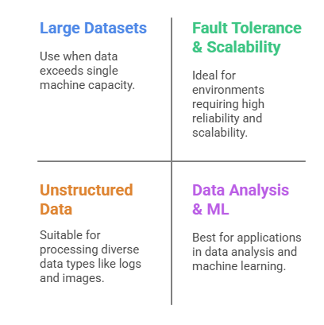
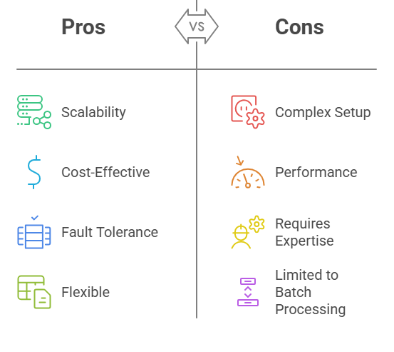
Apache Hadoop
Apache Hadoop is an open-source framework for processing large datasets across distributed computing environments. It consists of a storage part (HDFS) and a computational part (MapReduce). The main feature is its ability to handle big data by distributing the processing load across multiple machines.
Notes:
Apache Hadoop is an open-source framework designed to process and store vast amounts of data across distributed computing environments. It consists of two primary components: HDFS (Hadoop Distributed File System), which handles storage, and MapReduce, which manages data processing. Hadoop is well-suited for handling "big data," allowing tasks to be split into smaller jobs, processed in parallel across multiple machines, and then combined into a final result.
When to Use: You should use Apache Hadoop when dealing with large datasets that exceed the capacity of a single machine's storage or processing power. It is especially useful in scenarios where data is too big, unstructured (like logs, images, and videos), or when high scalability and fault tolerance are required. Hadoop is ideal for data analysis, machine learning, and managing large data warehouses.
Advantages:
Scalability: One of Hadoop's strongest points is its ability to scale easily. It can start small, running on just a few machines, but can grow to thousands of nodes without affecting performance or requiring a complete overhaul.
Cost-Effective: Hadoop can be run on inexpensive, commodity hardware, making it a more affordable solution for managing and processing big data.
Fault Tolerance: Data in Hadoop is replicated across multiple nodes, which ensures that in case of a failure, no data is lost, and the system can continue operating.
Flexibility: Hadoop is versatile, able to store both structured and unstructured data, giving users the freedom to analyze diverse data types.
Disadvantages:
Complex Setup: Hadoop requires a certain level of expertise to set up and configure, which may be challenging for beginners.
Performance Issues: For real-time or low-latency applications, Hadoop may not be the best choice, as the MapReduce process can take time to complete.
Requires Expertise: The management, maintenance, and optimization of Hadoop clusters require skilled professionals.
Limited to Batch Processing: While it is powerful for batch processing, Hadoop doesn’t handle real-time data processing efficiently.

Slide 3

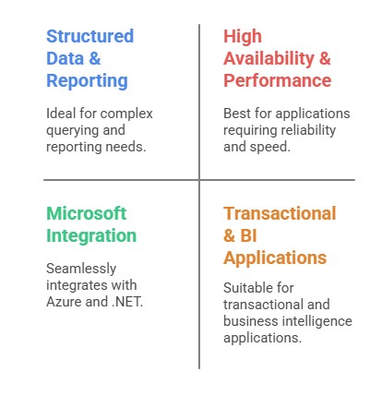
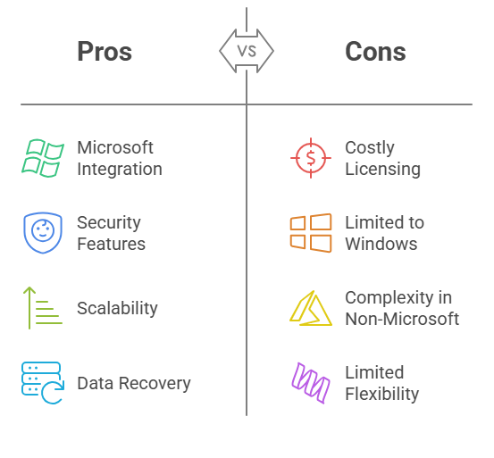
Microsoft SQL Server
Microsoft SQL Server is a relational database management system (RDBMS) developed by Microsoft. It uses a structured query language (SQL) for data management and supports business intelligence, analytics, and transactional processing.
Notes:
Microsoft SQL Server is a relational database management system (RDBMS) created by Microsoft. It uses Structured Query Language (SQL) for managing data, supporting not only the storage and retrieval of data but also business intelligence and complex analytics. It is widely used in enterprise environments for transactional processing, analytics, and reporting.
When to Use: Microsoft SQL Server is most suitable for projects that require handling structured data, like business applications, data analytics, and reporting systems. If you're working with data that needs to be organized into tables and queried using SQL, SQL Server is a great option. It's also ideal for applications that require high availability and integration with other Microsoft tools.
Advantages:
Integration with Microsoft Products: SQL Server seamlessly integrates with tools like Excel, Power BI, and Azure, making it an excellent choice for businesses already using Microsoft ecosystems.
Security Features: It comes with robust security features, including data encryption, access control, and auditing, helping ensure sensitive information is protected.
Scalability: SQL Server can handle very large databases and manage a high volume of transactions, ensuring performance remains high even as the database grows.
Data Recovery: SQL Server includes built-in tools for backup and disaster recovery, which are essential for business continuity.
Disadvantages:
Costly Licensing: The cost of licensing SQL Server can be expensive, especially for enterprise versions, which may be a barrier for smaller organizations.
Limited to Windows: Although recent versions support Linux, SQL Server is primarily designed for Windows, which may limit its compatibility with other operating systems.
Complexity in Non-Microsoft Environments: If you’re not already working in a Microsoft environment, integrating SQL Server with other systems can be challenging.
Limited Flexibility for Unstructured Data: SQL Server is not as flexible as NoSQL databases like MongoDB when dealing with unstructured data, such as documents or media files.

Slide 4
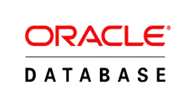
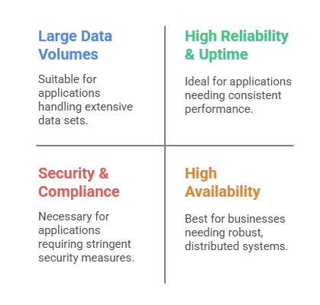
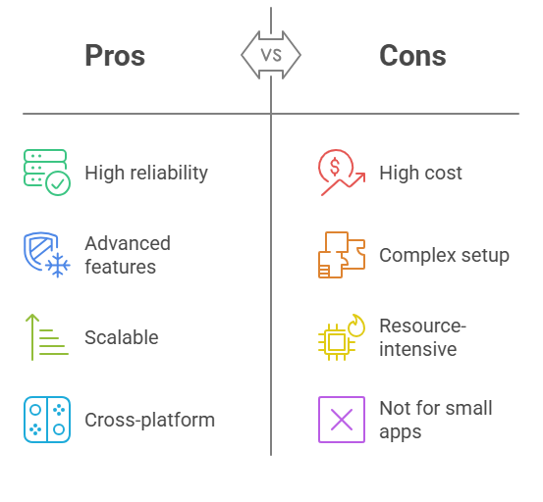
Oracle Database
Oracle Database is an RDBMS developed by Oracle Corporation. It’s used to store and retrieve data for applications across various industries. Known for high-performance and scalability in enterprise applications.
Notes:
Oracle Database is an RDB developed by Oracle Corporation, used to store and manage data for large-scale enterprise applications. Known for its high performance, scalability, and reliability, Oracle is widely used in industries requiring complex database management and critical transaction processing.
When to Use: Oracle is ideal for businesses that handle vast amounts of transactional data, particularly in sectors such as finance, healthcare, and telecommunications. It’s used when high reliability, advanced security, and large-scale data management are critical. Oracle is also a good choice for applications that require complex and high-volume transaction processing.
Advantages:
Reliability and Performance: Oracle is renowned for its high performance and ability to manage large volumes of transactions with minimal downtime.
Advanced Features: It offers sophisticated features such as advanced security options, automated backup, and recovery mechanisms to ensure data is always available.
Scalability: Oracle supports both vertical (increasing resources on a single machine) and horizontal (adding more machines) scaling, making it suitable for enterprises with growing data needs.
Cross-Platform Support: Unlike some RDBMS systems, Oracle supports multiple operating systems including Windows, Linux, and UNIX, offering greater flexibility for different environments.
Disadvantages:
High Licensing Costs: Oracle's licensing fees can be prohibitively expensive for small businesses, especially for enterprise-level deployments.
Complex Setup and Maintenance: Oracle requires specialized knowledge for installation, configuration, and ongoing maintenance, making it challenging for non-experts to manage.
Resource Intensive: It can consume significant system resources, especially for large applications, requiring powerful hardware to run efficiently.
Not Ideal for Small Applications: Due to its complexity and cost, Oracle may be overkill for smaller applications that don't require high-end features or scalability.

Slide 5
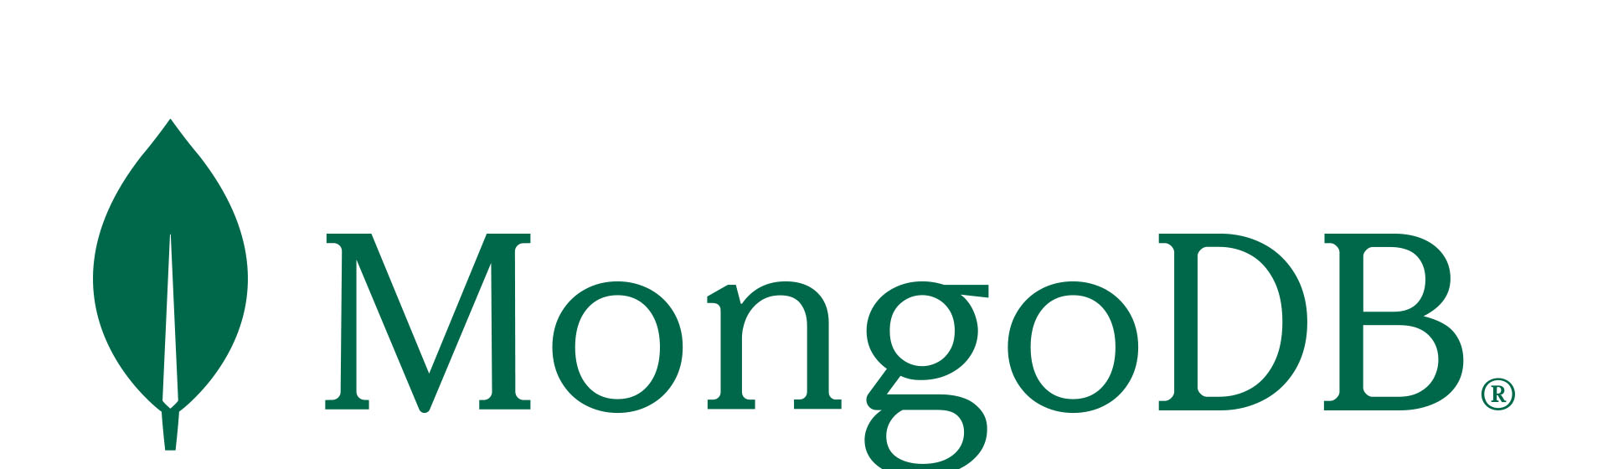
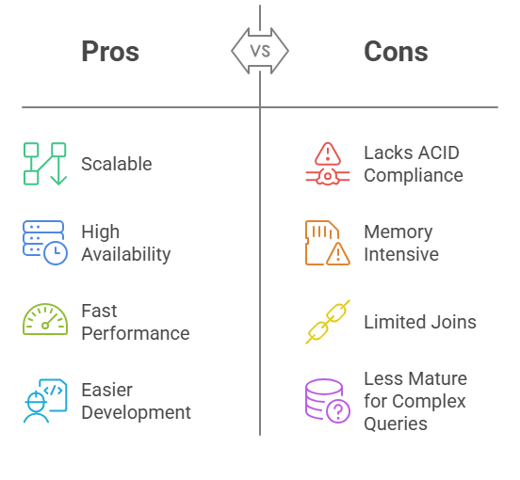
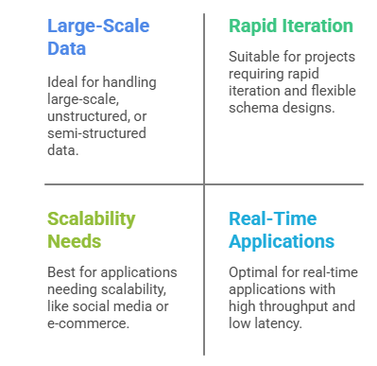
MongoDB
MongoDB is an open-source, NoSQL database that stores data in JSON-like format (BSON). It’s designed for high availability, scalability, and performance. It’s commonly used for applications dealing with large amounts of unstructured or semi-structured data.
Notes:
MongoDB is an open-source NoSQL database that stores data in a JSON-like format called BSON (Binary JSON). Unlike traditional relational databases, MongoDB is designed to handle large amounts of unstructured and semi-structured data. It is highly scalable and is used in environments where high availability and performance are essential.
When to Use: MongoDB is most useful when dealing with large-scale, unstructured, or semi-structured data. It is great for projects that require rapid development and flexibility, such as social media platforms, e-commerce sites, and real-time analytics applications. It’s also ideal for applications that need to scale horizontally to handle large amounts of traffic and data.
Advantages:
Scalable and Flexible: MongoDB supports horizontal scaling, which means it can spread data across multiple servers to manage large datasets effectively. Its flexible schema design allows for easy changes to data structure over time.
High Availability: With built-in replication and automatic failover, MongoDB ensures your data is always available, even in the event of server failures.
Fast Performance: MongoDB is optimized for quick read and write operations, making it ideal for real-time applications with high throughput.
Easier Development: Since MongoDB stores data in a JSON-like format, it’s easier to map data to application code, reducing the complexity of working with databases.
Disadvantages:
Lacks ACID Compliance: MongoDB doesn't fully adhere to ACID (Atomicity, Consistency, Isolation, Durability) principles, which could be problematic for transactional applications that require strict data consistency.
Memory Intensive: The database can be memory-heavy, particularly when indexing and processing large queries, which may require significant server resources.
Limited Join Operations: While MongoDB supports joins, they are not as efficient or straightforward as in relational databases, making it less ideal for complex queries involving multiple tables.
Less Mature for Complex Queries: MongoDB may struggle with complex analytical queries, making it less suitable for applications that require complex reporting or deep querying.

Slide 6
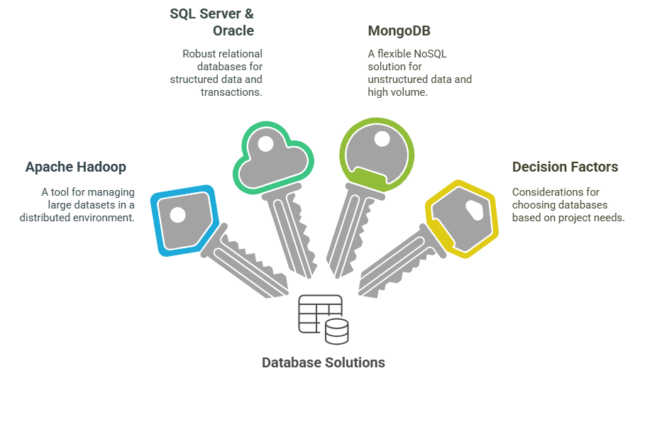
4 Key Learning Points of this Lesson
Notes:
Apache Hadoop is designed to manage large datasets across distributed computing systems, making it ideal for data-heavy applications like big data analytics. It is highly scalable and fault-tolerant, allowing it to handle both structured and unstructured data effectively.
Relational Databases for Transactional Systems: Both Microsoft SQL Server and Oracle Server are robust solutions for businesses that require structured data management. These systems excel at transactional processing, complex queries, and reporting, making them ideal for applications in finance, healthcare, and other data-intensive industries.
Scalability and Flexibility in Databases: MongoDB, as a NoSQL database, offers flexibility and scalability, particularly for unstructured data. Its ability to scale horizontally and its high availability make it a preferred choice for real-time applications and systems with large datasets.
Choosing the Right Tool: When selecting a database, consider the type of data you are working with, your need for scalability, the complexity of your queries, and the project’s budget. While Hadoop is great for massive datasets, SQL-based solutions are better for structured data and transactional systems, and NoSQL databases like MongoDB shine when flexibility and high-speed data processing are needed.

Slide 7
Thank You!
Shahriar’s Analytical Academy

